Slide 1
Membership Overview
This deck is available in your LFX Organizational Dashboard

Slide 2

















Intro to LF Energy
Growing portfolio of 30+ open source, freely available projects to accelerate your R&D
Supported by dozens of industry leaders
Synthetic data for the grid
Grid edge interoperability
AI for short-term forecasting
Transmission line rating exchange
Power system modeling

Slide 3





Where does LF Energy fit?
Publications, conferences, standards
Publications, conferences
We complement existing collaborative efforts by focusing on:
Open collaboration, following the best practices used by the most innovative organizations in the world
High Technology Readiness Level (TRL) projects, hardened and ready for deployment
Partnership between vendors and their customers to create commercial solutions on top of open platforms
A community for digital experts (software engineers, data scientists, etc) working in energy
Open industrial-grade technology platforms and agile standards
Early-stage research and prototypes
Advocacy for investor-owned electric companies

Slide 4
For energy, open source benefits by market segment
As a system operator / utility
Advocate for open interoperable solutions as part of you procurement process
Partner with your vendors and peers to co-develop solutions
Benefits: shared costs, better code quality, interoperability, transparency, less lock-in
As a vendor
Co-develop open shared foundations to ease system integration and focus on high value components and services
Benefits: respond better and faster to your customer needs, out-innovate your competitors, less integration burden
As an R&D institution (academia, national lab)
Structure your projects using open-source best practices from the very beginning
Collaborate with vendors and utilities
Benefits: better long-term impact and path to market, align your work with industry needs
As a regulator / funding agency
Encourage reference implementations, open standards, open source procurement
Leverage open innovation as a sustainable path to market for R&D projects
Benefits: transparency, lower tariffs, more impact from public R&D funding

Slide 5
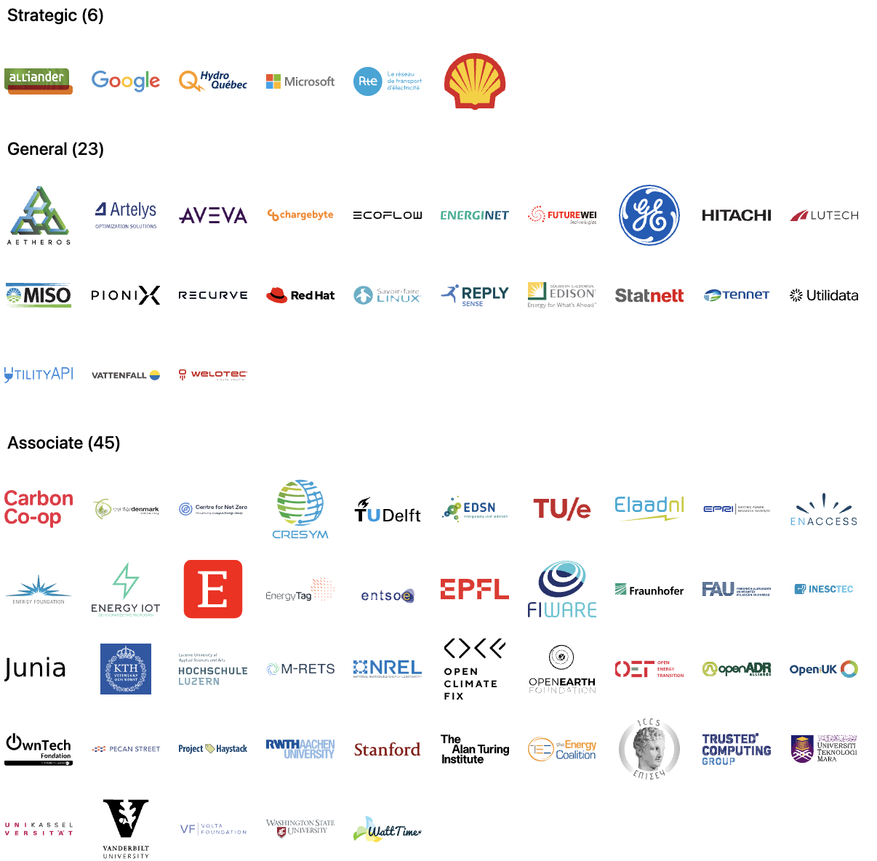
Members
Notes:
Source: https://landscape.lfenergy.org/embed/embed.html?base-path=&classify=category&key=lf-energy-member&headers=true&category-header=false&category-in-subcategory=false&title-uppercase=false&title-alignment=left&title-font-family=sans-serif&title-font-size=24&style=clean&bg-color=%23ffffff&fg-color=%23000000&item-modal=false&item-name=false&size=md&items-alignment=left

Slide 6
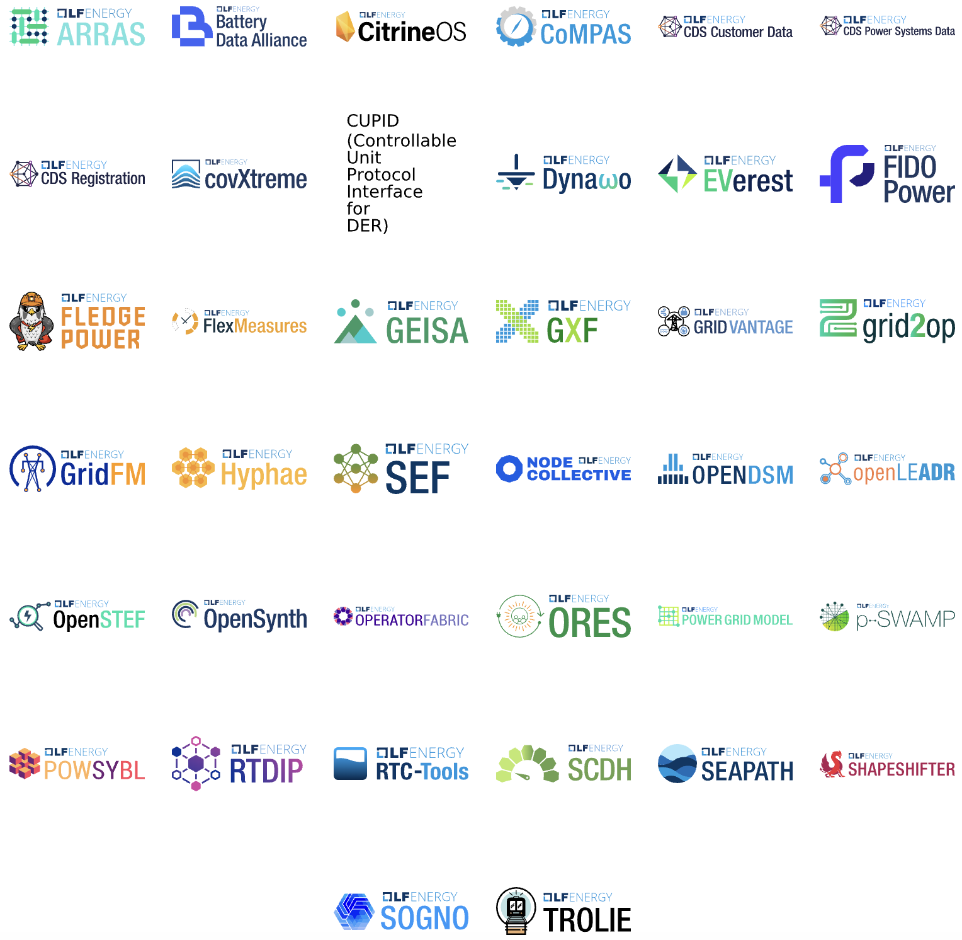
Projects
Notes:
Source: https://landscape.lfenergy.org/embed/embed.html?base-path=&classify=category&key=sig&headers=false&category-header=true&category-in-subcategory=false&title-uppercase=false&title-alignment=center&title-font-family=sans-serif&title-font-size=13&style=clean&bg-color=%23009ade&fg-color=%23ffffff&item-modal=false&item-name=false&size=lg&items-alignment=center&items-spacing=0

Slide 7
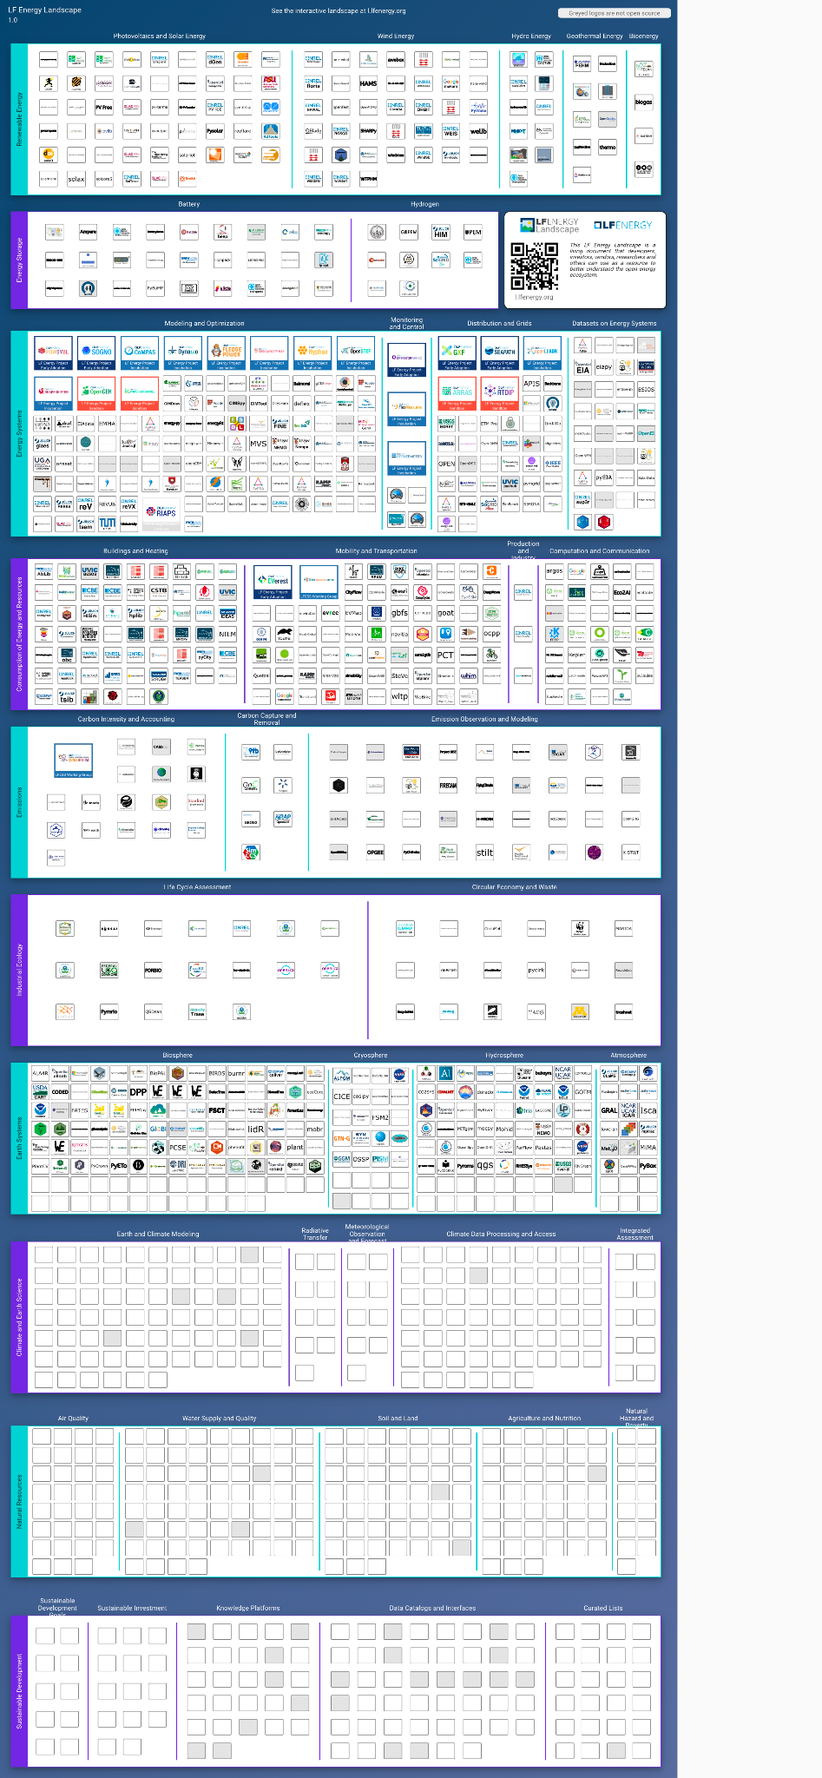
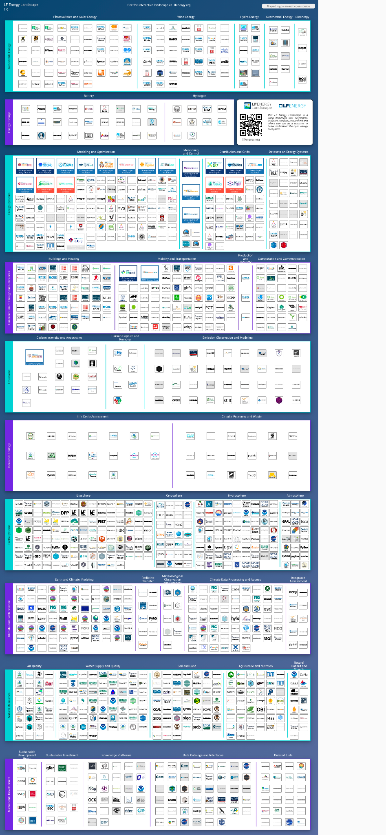

LF Energy Landscape
l.lfenergy.org
1,343 projects, market cap of $7.5T and funding of $17B.
Notes:
Source: https://landscape.lfenergy.org/fullscreen/

Slide 8
Governance

Slide 9
Governance at a Glance
Fiduciary Governance - Membership driven
Technical Governance - Open to all
Governing Board
Technical Advisory Council (TAC)
Budget Committee
LF Energy Standards and Specifications (LFESS)
Steering Committee
Technical Projects
Working Groups/SIGs
Marketing Advisory Committee (MAC)
Standards
Working Groups

Slide 10
Governing Board overview
Comprised of one (1) voting representative from each Strategic LF Energy member, two (2) annually elected General member, the TAC Chairperson, the Governing Board’s responsibilities include:
Deciding on strategic business orientations, approving budget and new projects
Electing a Chair to preside over Governing Board meetings, authorize expenditures approved by the budget and manage any day-to-day operations
Overseeing all Project business, marketing, outreach and trademark matters

Slide 11
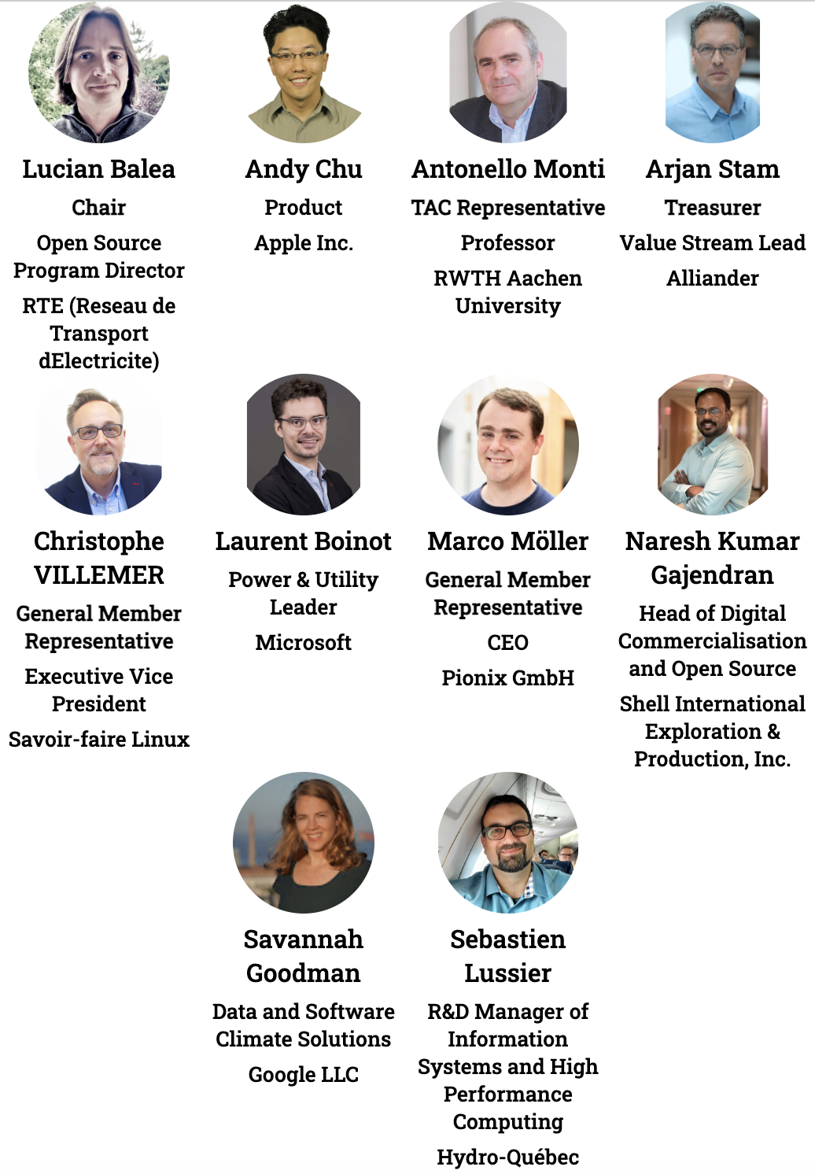
Governing Board
voting representatives
Notes:
https://jmertic.github.io/committee-gallery/lf-energy-foundation-governing-board
Zoom to fit

Slide 12
Appointing your Governing Board representative
( Strategic Member benefit )
As a Strategic Member, you are entitled to appoint a representative from your organization to serve on the Governing Board.
Expectations of this role:
Attend monthly Governing Board meetings ( 1st Wednesday of the month at 8:00 am US Pacific Time )
Participate in membership recruitment activities, including monthly membership pipeline review call.
Be available from time-to-time for strategic discussions and calls.
ACTION: To appoint your representative, please file a request at members.lfenergy.org, and have the representative create an LF ID.
You can change your representative at any time by making a request at members.lfenergy.org.

Slide 13



Governing Board representative election
( General Member benefit )
Per the LF Energy charter, Section 2(c):
General Members, acting as a class, will be entitled to annually elect one representative to the Governing Board for every ten General Members, up to a maximum of three representatives, provided that there will always be at least one General Member representative, even if there are less than ten General Members. The Governing Board determines the election process.
The General Member class elects new representative(s) during the month of June to serve a term from July 1st through June 30th the following year.
ACTION: Look for details regarding the election in April/May.
If you have any questions about this process or the role, please contact us at members.lfenergy.org.

Slide 14
Technical Advisory Council (TAC) overview
The TAC is the technical governance heart and soul of LF Energy. As new projects get contributed to LF Energy they get reviewed and approved by this committee.
TAC members consist of Strategic members as well as the project leads for all active projects. Anyone in the community can attend TAC meetings.
The TAC meets every 3 weeks on Tuesdays, and members are invited to attend these calls. Subscribe to the technical mailing list at lists.lfenergy.org/g/tac for more information and add the TAC Meeting to your Calendar Now.

Slide 15
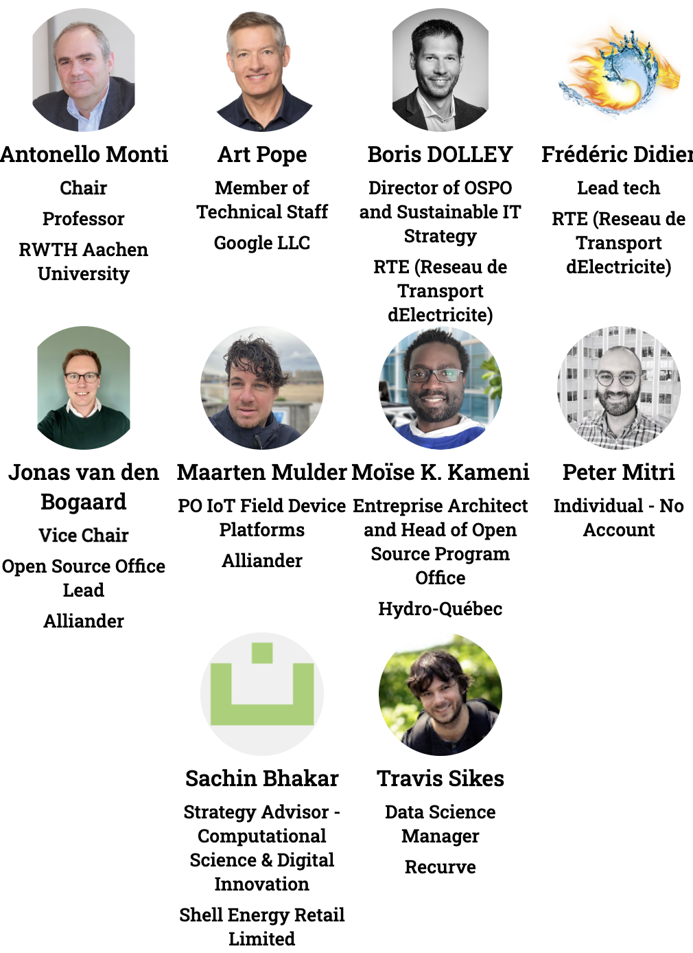
Technical Advisory Council (TAC)
voting representatives
Notes:
https://jmertic.github.io/committee-gallery/lf-energy-foundation-tac
Zoom to fit

Slide 16
Appointing your TAC representative
( Strategic Member benefit )
As a Strategic Member, you are entitled to appoint a representative from your organization to serve on the TAC. Expectations of this role:
Attend TAC meetings held every three weeks on Tuesday at 8:00am US Pacific Time.
Be available to serve as a TAC mentor to new projects coming into LF Energy
Participate in out of meeting discussions.
Be available from time-to-time for strategic discussions and calls.
ACTION: To appoint your representative, please file a request at members.lfenergy.org, and have the representative create an LF ID.
You can change your representative at any time by making a request at members.lfenergy.org.

Slide 17
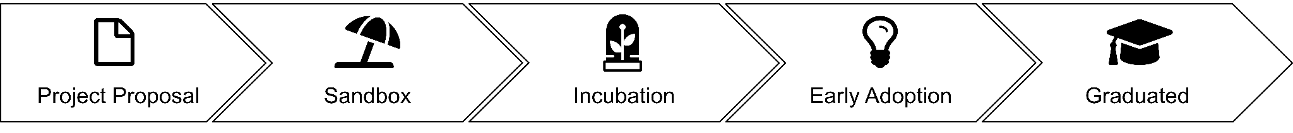
LF Energy project lifecycle
Projects can become part of LF Energy through the submission of a mature code base.
Projects can also be formed through working groups or special interests groups that submit a proposal and then form as a project.
Learn more at lfenergy.org/host-your-project

Slide 18
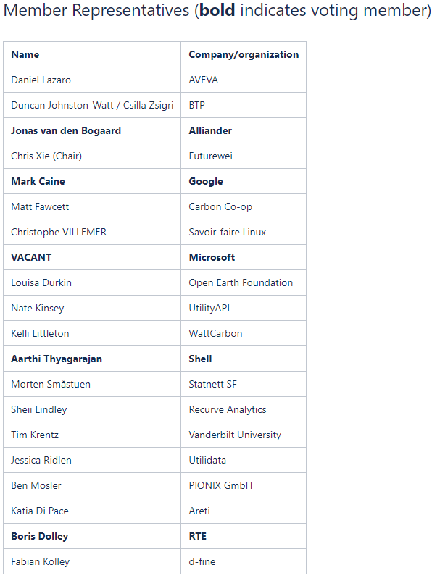
Marketing Advisory Committee (MAC)
The MAC advises on marketing and communications strategies including events and campaigns.
The MAC is made up of representatives from all members. There is no cap on the number of committee members.
The MAC meets the 4th Thursday of each month at 7 am US Pacific, and members are invited to appoint a representative to attend these calls.
Recordings and minutes from prior meetings are available publicly.

Slide 19
Appointing your MAC representative
( Open to all members )
As an LF Energy Member, you are entitled to appoint a representative from your organization to serve on the MAC. Expectations of this role:
Attend MAC meetings held the 4th Thursday of each month at 7 am US Pacific / 10 am US Eastern / 16:00 Central European Time
Participate in out-of-meeting discussions.
Be available from time-to-time for strategic discussions and calls.
ACTION: To appoint your representative, please complete this form (select “Marketing/PR” then “Add or Change Marketing Committee Member”).
You can change your representative at any time by making a request at the same link.

Slide 20




LF Energy staff
Alex Thornton, LF Energy Executive Director
Dan Brown, Marketing Director
John Mertic, Program Director
Yarille Ortiz, Sr. Project Coordinator
Support requests for the staff can be made at support.lfenergy.org.

Slide 21
LFX Organization Dashboard
LFX Organization Dashboard provides access to key membership materials, including…
Member contacts, which you can change at any time ( look under ‘Users’ > and then under the ‘Key People’ tab )
Membership details ( look under ‘Membership’ > ‘LF Energy Foundation’ ), including…
Membership Overview Deck and High Level Overview Deck ( look under the ‘Resources’ tab )
Your fully executed membership agreement ( look under the ‘Membership’ tab )
Details on how to leverage membership benefits ( look under the ‘Benefits’ tab )
Insights on contributors from your organization ( look under the ‘Project Contributors’ tab )
ACTION: Request access to LFX Organizational Dashboard here.

Slide 22
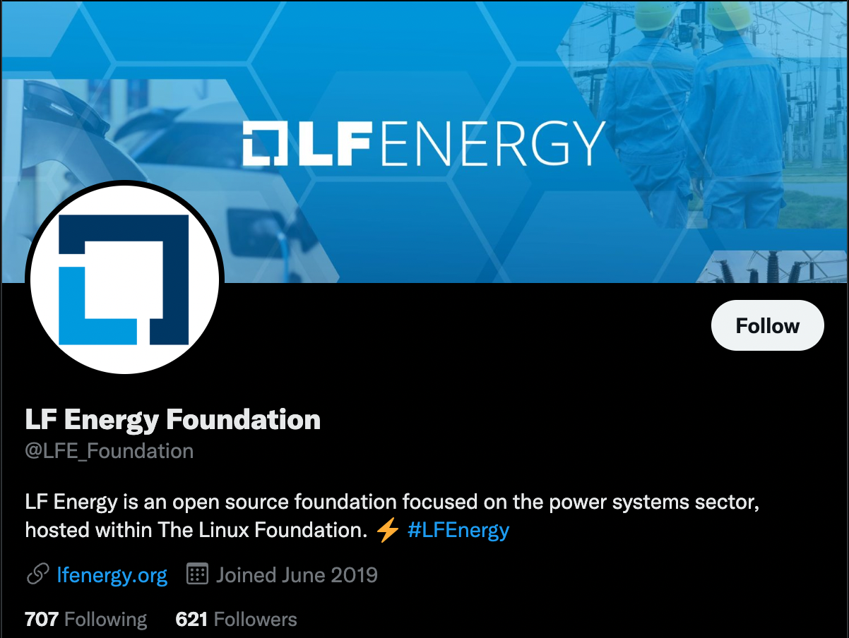
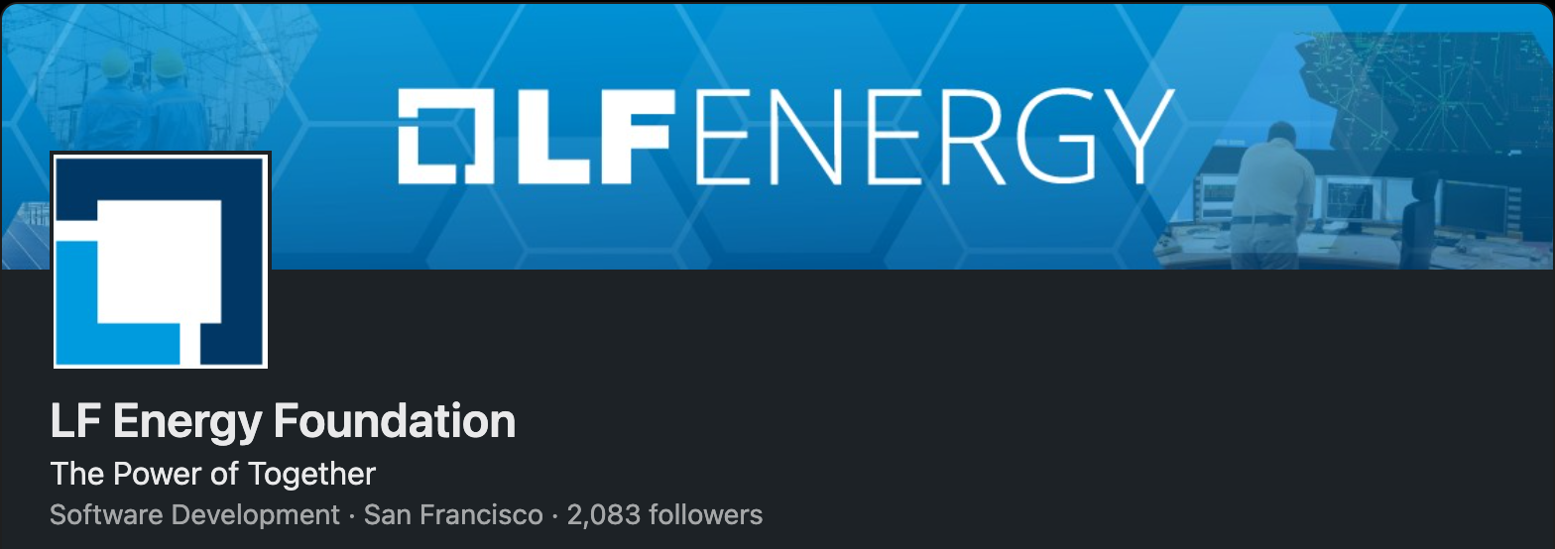
Make sure you are following us on social!
Follow us on LinkedIn at linkedin.com/company/lf-energy-foundation
Follow us on Twitter at twitter.com/LFE_Foundation
And sign up for the LF Energy newsletter to keep up to date on project happenings

Slide 23
Leveraging your membership benefits

Slide 24
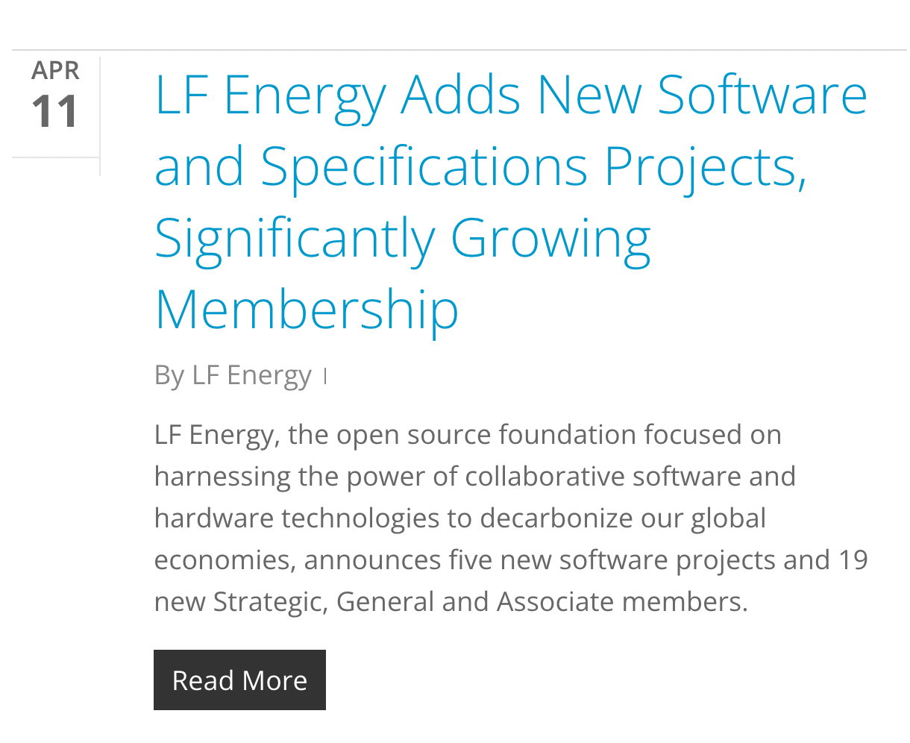
Announcing your membership
We will include your company in an upcoming momentum press announcement. These are typically done quarterly and timed around events for maximum impact.
ACTION: Please provide 1-2 sentences on your company, name of a spokesperson, and a quote to include in the press announcement. Submit request to members.lfenergy.org.
Please note that these announcements are often picked up by press and media, and there may be requests for briefings.

Slide 25

Marketing and Event Benefits
The LF Energy staff is here to help you get connected with hosted projects and other members, ensuring value for your investment in the LF Energy Foundation.
All members receive the following benefits:
Support for member announcements and member PRs
If member requests, LF Energy will provide quote for member press release or blog
Logo on the website once your membership has been announced
Discount on Event Sponsorship packages
ACTION: Contact us at members.lfenergy.org for more details.
You can get LF Energy member logos to use on your website and materials at artwork.lfenergy.org/other/lf-energy-member/

Slide 26


Participate in Standards Development
LF Energy Members can contribute to the specifications being driven under LF Energy Standards and Specifications by completing the membership agreement at joinnow.lfess.energy.
As an LF Energy Strategic Member, you receive representation on the LFESS Steering Committee
As an LF Energy General Member, you can run for election to serve on the LFESS Steering Committee.
More information on LFESS Governance at https://github.com/lf-energy/lfess-resources/blob/main/GOVERNANCE.md

Slide 27






Additional Benefits for Strategic Members
Strategic members are key partners in driving the direction of the LF Energy Foundation, and we partner closely with in driving the mission and vision of the foundation.
Exclusive benefits for Strategic members include:
Send signal that you are committed and serious about the energy transition and 100% planetary decarbonization
Guaranteed seat on the LF Energy Governing Board and LF Energy Technical Advisory Council, where your organization can shape where funds are directed, direction of project investments, branding, messaging, PR, marketing, developer events, training
Placement of member brand at forefront of LF Energy web properties and promotion in top news outlets
Participation in Linux Foundation Member Summit (Additional Seat)
Direct assistance with your open source strategy activities, and R&D portfolio, with premium access to the project ED to understand business goals help you succeed in those goals any way possible and premium access to the LF Energy open source leadership to advise member of advancing brand leadership worldwide in open source
LF Leadership support to keynote member events, participate in outreach (eg roadshows, events, conference meet ups etc..)
Priority for hosting LF Energy Roadshows and meetups at the location of their choice
2x guest blog pieces on LF Energy blog
ACTION: Contact us at members.lfenergy.org for more details.
Current Strategic Members

Slide 28




Contact Us
Linux Foundation Energy
548 Market St PMB 57274 San Francisco CA 94104 Phone/Fax: +1 415 723-9709 www.lfenergy.org
General Inquiries
support@lfenergy.org
Membership
membership@lfenergy.org

Slide 29
Projects in Detail

Slide 30
Digital Substations

Slide 31
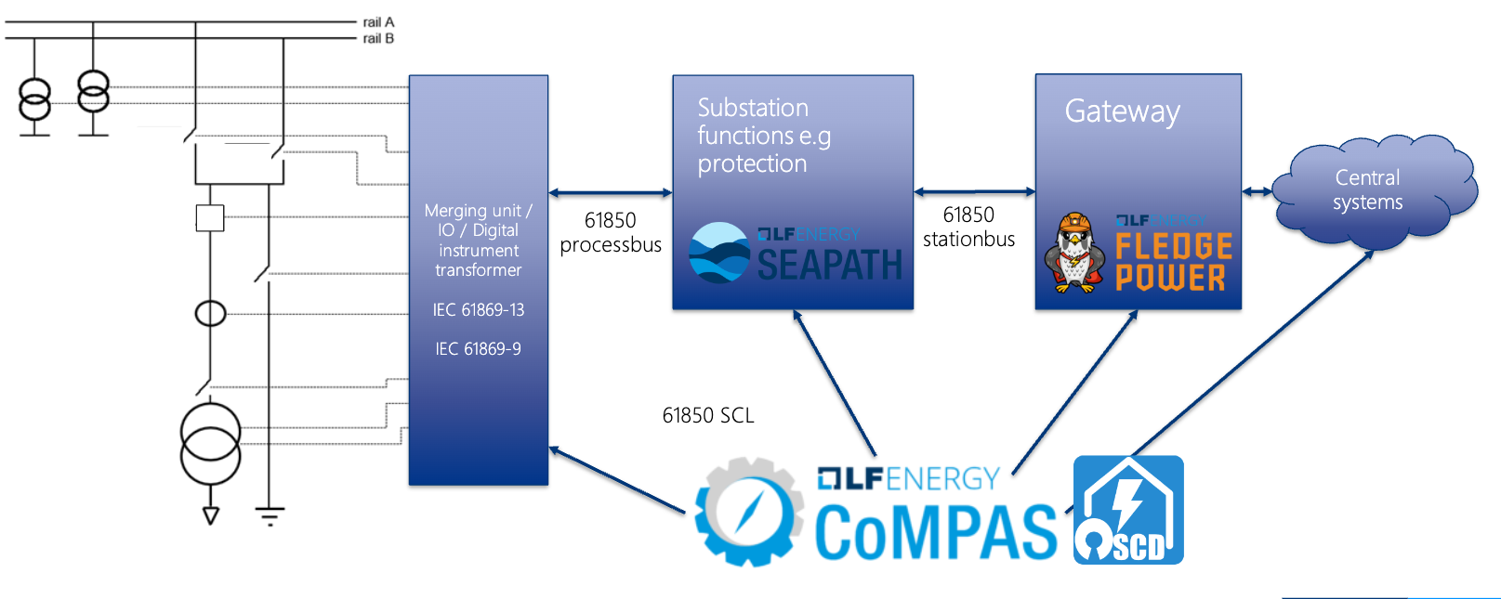
Digital Substation Architecture

Slide 32

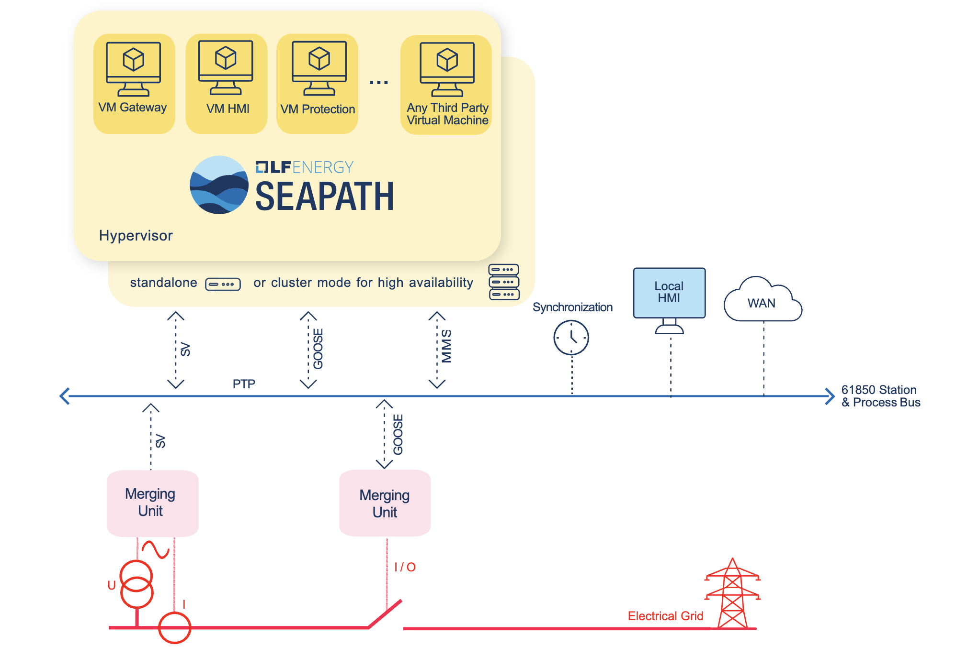







High availability real-time hypervisor for hosting digital substation virtualized protection and control applications (vPAC)
SEAPATH is an open source software hypervisor designed for IEC 61850 Digital Substation Automation Systems. SEAPATH hosts and runs vPAC (Virtualized Protection, Automation and Control) applications for the power grid.
Ecosystem agnostic, easily used and extended by third parties
High performance, ready for IEC 61850 applications
Resilient, robust for mission-critical systems
Infrastructure as code, allowing automated and remote system management
Intensive testing, guaranteeing capabilities and avoiding regression
Virtualization, to run virtual machines hosting Operational Technology (OT) functions

Slide 33

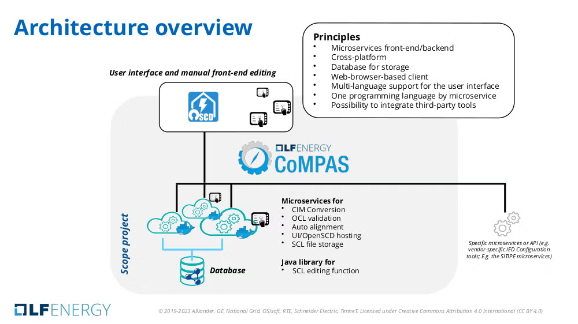



Open source profile configuration and management for IEC 61850 substation protection, automation, and control systems
Common software blocks for IEC 61850 profile configuration, using an open source shared development model, accelerating conformity to IEC 61850 through software implementation.
Tools for IEC 61850 profile management and configuration are needed at various business processes of the power grid industry
The planning process for grid infrastructure components facilitates the design of power system adaptations and the engineering of substation PACS to be installed or upgraded
Specifying requirements and performing multi-vendor system integration and commissioning during the PACS procurement and delivery phase
Adapting to changes in operational conditions and performing system configuration updates during the operational life of PACS
Managing assets in order to perform maintenance actions and PACS upgrades
Improving the interlinkage between grid planning and PACS engineering processes
Improving the interlinkage between the configuration of PACS and the configuration of central systems, including SCADA and asset management

Slide 34

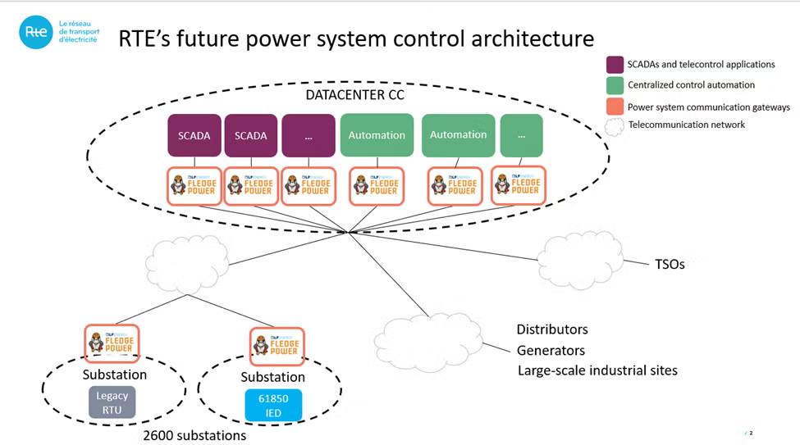




Open source, multi-protocol translation gateway for power systems built upon the industrial IoT LF Edge Fledge
Flexible, lightweight, industrial-grade, open source gateway that embeds Fledge (LF EDGE). Additionally, FledgePOWER provides a toolbox for simulation, data configuration, and checking focused uniquely on power systems’ protocols translation and power systems’ use cases.
Lightweight: it can run on small computers with constrained resources
Extensible: new protocols need → new plugin
Modular: each part is a small consistent brick that runs as a microservice
Flexible: install only what you need where you need it
Scalable: it can be deployed on a single instance or scale to thousands of sites
Secured: it uses state of the art secured techniques and protocols
Interoperable: generic interface model enables integration with heterogeneous legacy or future products and systems

Slide 35
EV Charging

Slide 36

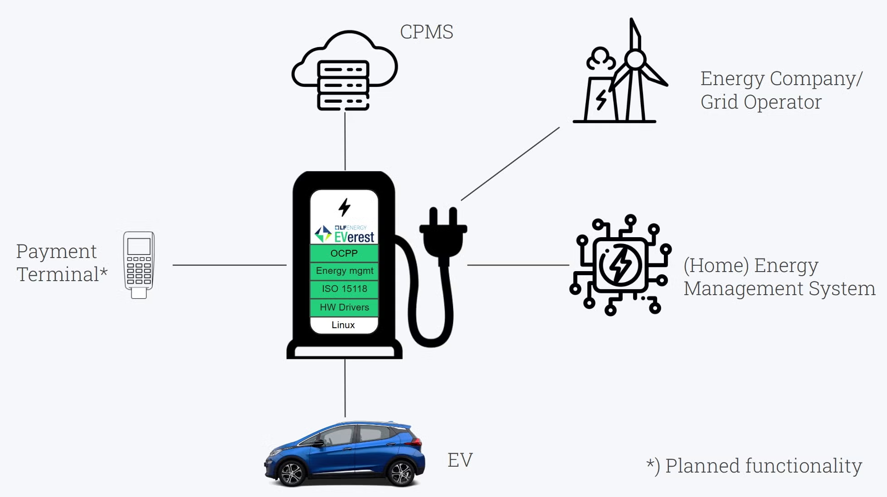




Open source firmware stack for standards-compliant, interoperable, and secure EV charging
EVerest is the open-source firmware stack for EV charging stations. It runs on any device, from simple home chargers to complex public stations, supporting all the standards and protocols needed for seamless and secure interoperability between every electric vehicle, charger, and network.
Modular Architecture: Interchangeable modules, allowing for customizable charging scenarios (e.g., AC wallboxes, DC fast chargers, commercial systems).
Standards Compliant: Supports key industry standards like OCPP (1.6, 2.0.1, 2.1) and ISO 15118 (including Plug & Charge), ensuring broad compatibility.
Interoperability: Simplifies communication between the EV, charger, local energy generation (like PV), grid, and cloud backends.
Hardware Agnostic: Can run on various hardware platforms, from simple home chargers to complex public charging stations.
Cybersecurity-Focused: Developed with security in mind, benefiting from community-driven testing and continuous improvement.

Slide 37

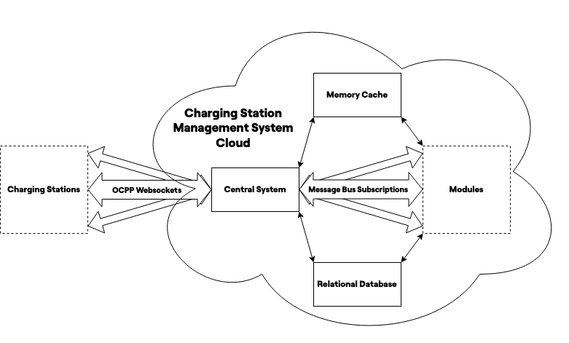

Open source OCPP and NEVI compliant Charger Station Management System (CSMS)
CitrineOS is a Charging Station Management System (CSMS) software stack designed for building and managing EV charging networks. It is OCPP 2.0.1 and NEVI compliant, providing a flexible, modular, and vendor-agnostic solution for controlling, monitoring, and managing transactions across charging stations.
OCPP and NEVI Compliant: Meets the latest industry standards and regulatory requirements.
Modular & Extensible: Allows for flexible deployment and easy integration of new functionalities.
Comprehensive CSMS Functionality: Enables provisioning, remote control, transaction management, and energy consumption management.
Hardware Agnostic: Can manage charging stations from various manufacturers, preventing vendor lock-in.
Cybersecurity & Reliability: Developed with a focus on security and reliable operation.

Slide 38
Data Standards and Tooling

Slide 39

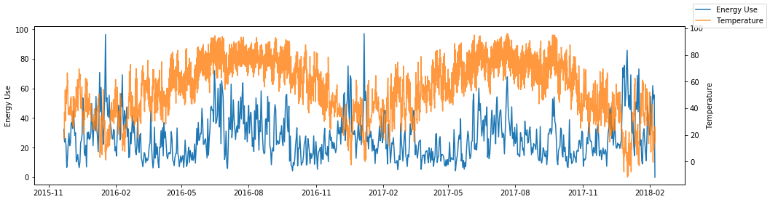



Measures the impacts of demand-side energy programs (like energy efficiency and demand response) by modeling historical energy usage to predict counterfactuals and compare them to actual post-intervention consumption
OpenDSM is a software library that measures the impact of demand-side programs, like energy efficiency and demand response. It uses historical data to predict energy consumption and compares it to actual use, providing a transparent and standardized way to quantify a program's effect.
Impact Measurement: Accurately measures the load impacts of demand-side programs.
Predictive Modeling: Creates counterfactual models using historical data to predict energy consumption.
Data-Driven Toolkit: Provides a suite of modules like EEmeter and DRmeter for comprehensive analysis.
Regulatory Compliance: Its methodologies have been approved by the U.S. Department of Energy (DOE) for federal programs.
Program Optimization: Offers consistent data to help grid operators and program administrators with planning and resource allocation.

Slide 40




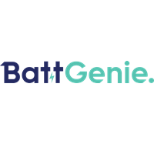


Sustainable open source software, best practices, and delivery standards for the battery industry
The Battery Data Alliance (BDA) is a collaborative project that builds software and standards for the battery industry. Its goal is to unify how battery data is handled, from research to recycling, to accelerate innovation and enable a circular battery economy.
Standardized Data Model: Creates a common framework for battery data.
Accelerates Innovation: Provides tools so researchers can focus on new solutions instead of data management.
Interoperability: Unifies data handling across the battery lifecycle.
Grid Integration: Creates the data foundation for integrating batteries as grid resources.

Slide 41

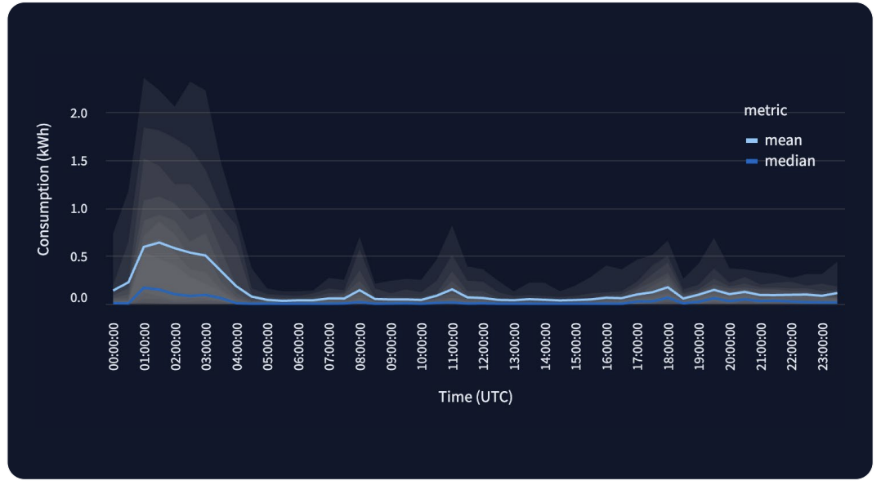


Open data community democratizing access to AI-generated synthetic and real energy data
As energy systems seek to transition, the need for granular, interoperable, and transparent data grows – not just for demand, but for grid infrastructure, supply, flexibility, and more. OpenSynth includes both synthetic and real datasets, across a wider range of domains, designed to support researchers, developers, and system operators in building robust, AI-ready models of the energy system.
AI-generated synthetic datasets for energy research and modelling
Real or synthetic system data enabling training of advanced AI models

Slide 42

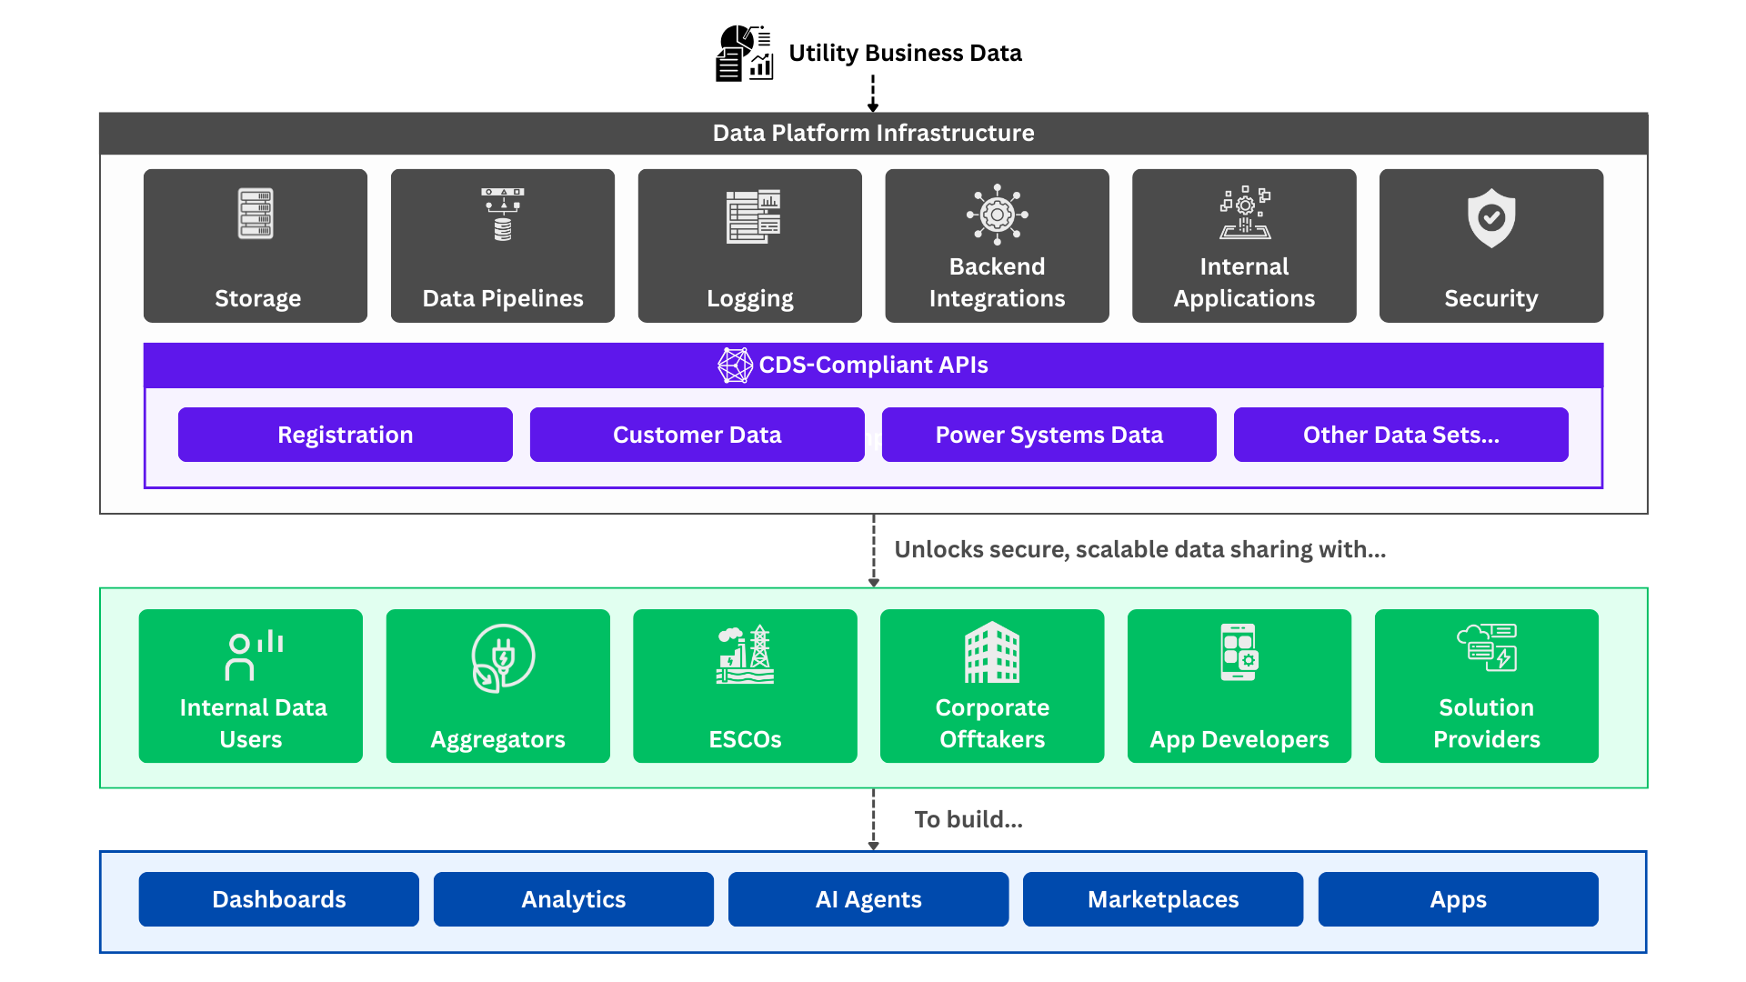


Specifications for secure, standardized access and sharing of energy-related data
Next-generation data specifications for standardized, secure data access and sharing designed for modern machine communication and AI, building the foundation for tomorrow’s energy grid.
🔒 Secure by Design
🧠 AI Ready
🧩 Broadly Applicable, Uniquely Adaptable
🚀 Evolving with the Speed of Digitalization
Discovery: Find what utilities and other central entities that offer data access.
Registration + Connectivity: Sign up, establish, and manage secure connections with central entities.
Authorization: Get individual customer consent to access their data.
Data Access: Retrieve authorized data in a standardized format.

Slide 43

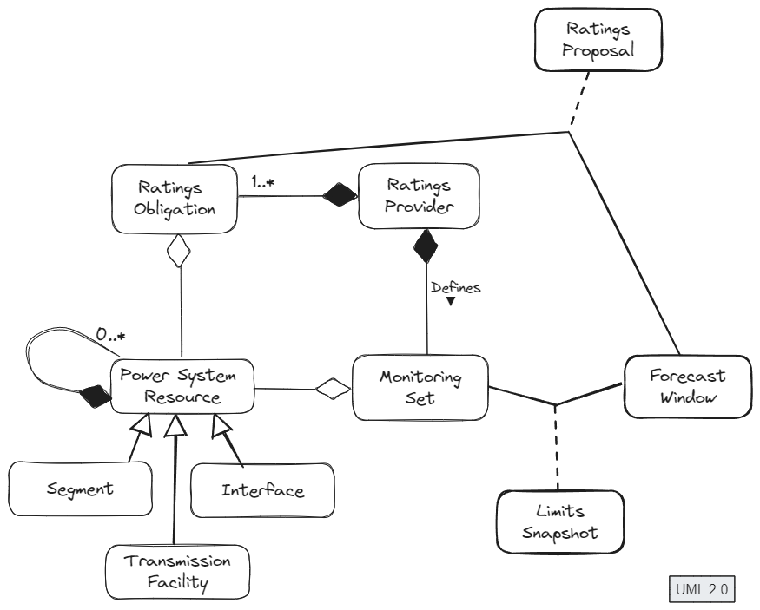




Standardizes the exchange of transmission facility ratings and operating limits
Establishes a common, open standard for exchanging transmission facility ratings and operating limits. It helps grid operators comply with regulations like FERC Order 881 by providing a vendor-neutral API specification. This simplifies interoperability and accelerates the implementation of reliable and secure data exchange systems.
API Specification: Defines a standard API for exchanging transmission data.
Client SDKs: Provides ready-to-use client SDKs (e.g., Java) to simplify development.
Ensures Conformance: Offers a program for vendors to test and demonstrate compatibility with the specification.
Regulatory Compliance: Helps meet the requirements of FERC Order 881.
Simplifies Interoperability: Enables seamless data exchange between different systems and vendors.

Slide 44
Grid Operations

Slide 45

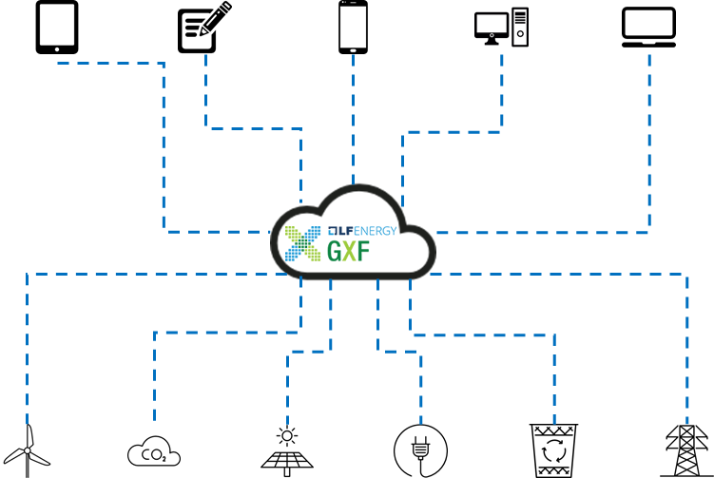
IoT platform that enables grid operators to securely collect data, monitor, control, and manage smart devices
A scalable platform that serves as a communication bridge between grid devices and digital applications. It provides a single, secure method for operators to collect data and send commands to a wide array of smart devices, simplifying the management of a complex grid.
Centralized Device Management: Provides a single platform for managing, controlling, and collecting data from a wide range of devices.
Data Collection & Control: Allows for the secure collection of data from devices and the sending of commands for tasks like remote firmware updates or managing energy schedules.
Protocol Abstraction: Acts as a translating layer to simplify communication between various industrial protocols and central applications.
Scalability & High Availability: The architecture is designed to connect to a nearly endless number of devices and can be deployed in a way that ensures continuous operation.

Slide 46

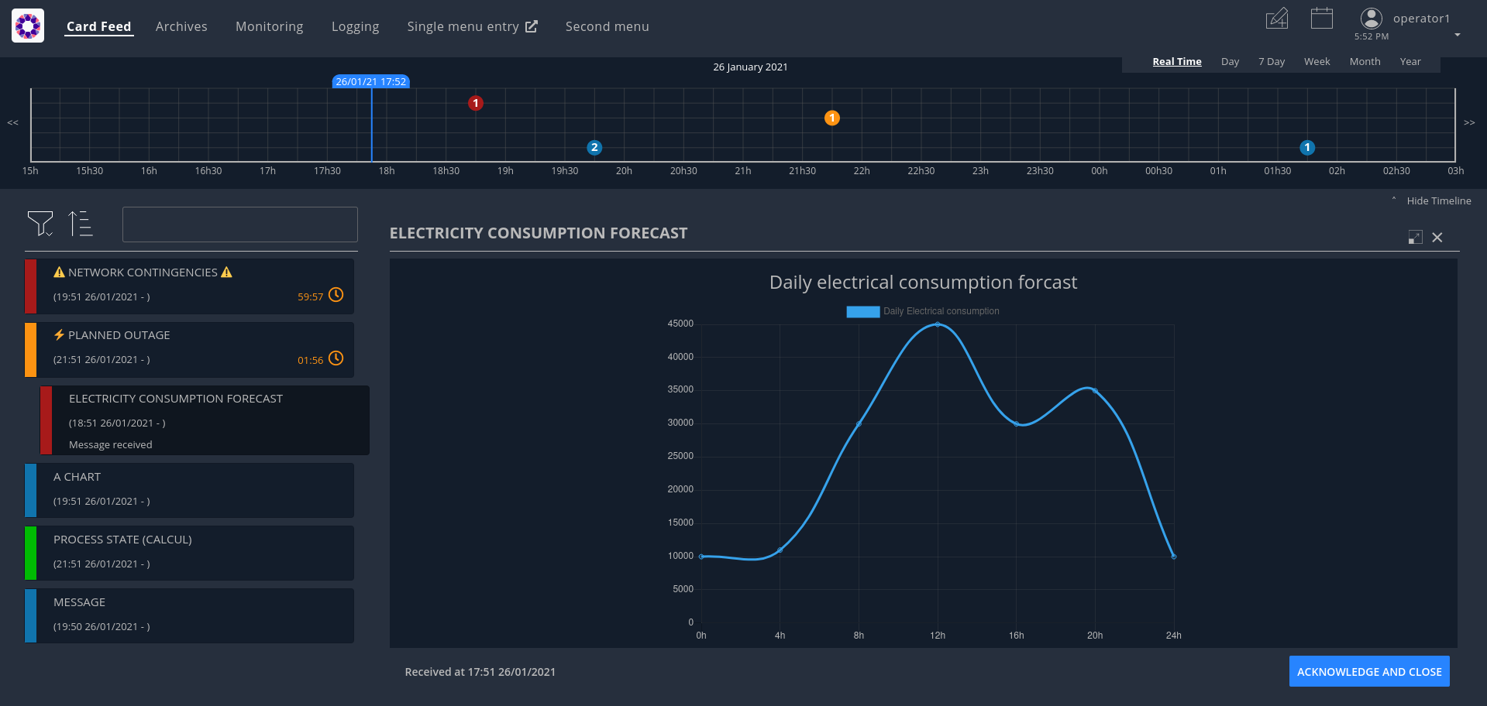

Centralize and manage real-time business events and facilitate interactions for system operators
Modular, industrial-strength platform that provides a unified human-machine interface (HMI) for grid operations. It centralizes real-time events and data from various applications and systems into a single screen, eliminating the need for operators to use multiple displays. By streamlining information and facilitating communication between control centers, OperatorFabric enhances situational awareness and simplifies complex operational tasks.
Unified Interface: Aggregates real-time data and events from disparate sources into a single, cohesive dashboard.
Workflow Management: Facilitates interactions between control centers through a structured messaging system for coordinating tasks and responses.
Integration Framework: Integrates with existing IT systems and business applications via APIs (e.g., REST, Kafka) and supports Docker deployment.
Enhanced Situational Awareness: Presents information with features like timelines, event archiving, and customizable visualizations to improve decision-making.

Slide 47

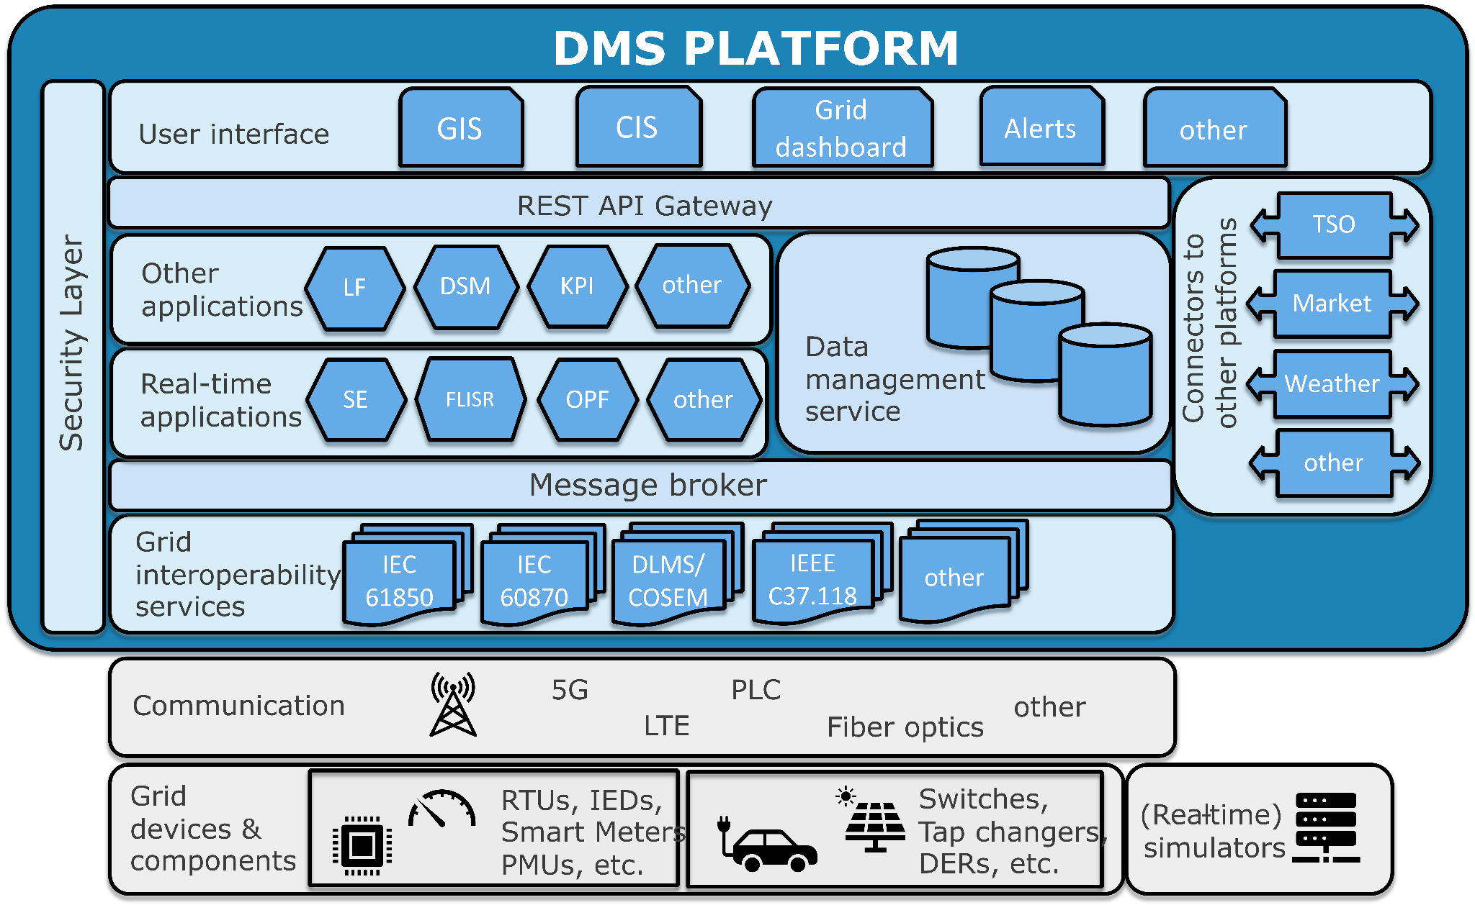



Advanced Distribution Management System
A platform for the real-time, automated management of distribution grids. It uses a service-oriented architecture (SOA) to deploy grid management functions as modular, interoperable services. Simplifies the integration of new technologies, such as distributed energy resources, and enhances the flexibility and resilience of the grid.
Automated Grid Management: Automates key operational tasks for distribution grids in real time.
Modular Architecture: Allows grid management functions to be deployed as modular services for greater flexibility.
Resilience Enhancement: Improves the grid's ability to detect and isolate faults, and manage distributed energy resources.
Microgrid Integration: Supports the management and operation of microgrids, which is crucial for decentralized energy systems.
Real-Time Operations: Provides a platform for real-time monitoring and control of the grid.

Slide 48

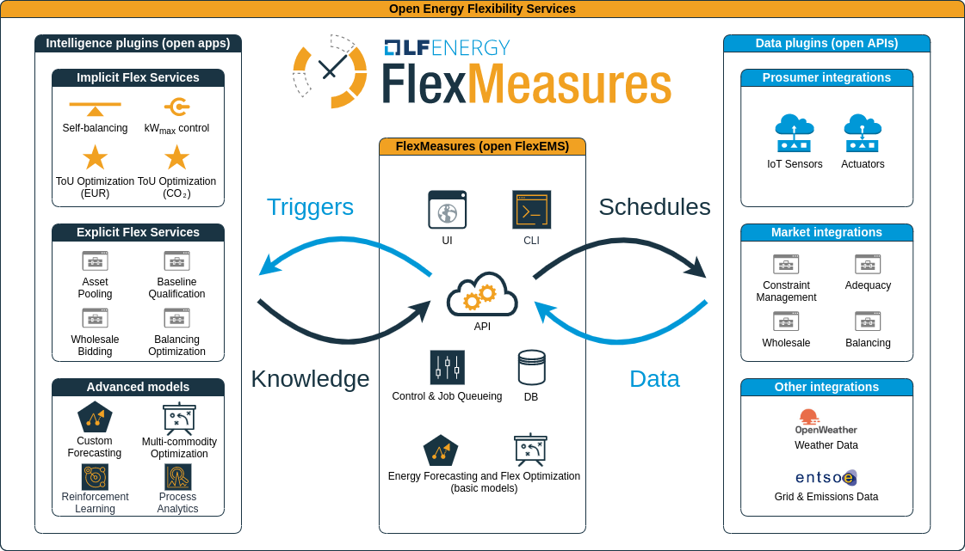

An intelligent EMS (energy management system) to optimize behind-the-meter energy flexibility
An intelligent platform for managing and optimizing energy flexibility. It helps grid operators and service providers turn data from flexible assets—like batteries, EVs, and heat pumps—into optimized schedules. By forecasting energy consumption and production, FlexMeasures supports real-time decision-making, helping to balance the grid and lower costs and carbon footprint.
Flexibility Management: Provides a toolkit for managing and scheduling flexible energy assets.
Forecasting and Optimization: Predicts energy consumption and production to create optimal schedules.
Real-time Operations: Designed to support real-time data integration and intelligent, automated decisions.
API-driven: Offers a well-documented API for seamless integration with other systems and applications.
Simulation and Reporting: Supports "what-if" scenarios for planning and provides reporting on the effects of optimization.

Slide 49

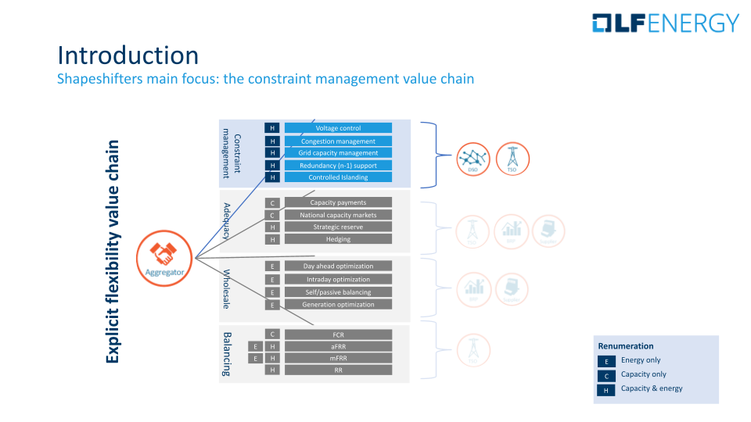

Protocol that standardizes market communication for energy flexibility, enabling aggregators and grid operators to forecast, offer, order, and settle flexibility to manage grid congestion
Shapeshifter is a protocol and framework that enables the trading and exchange of energy flexibility. Based on the Universal Smart Energy Framework (USEF), it provides a common language for grid operators and aggregators to communicate about congestion management, capacity limits, and flexibility procurement. By standardizing these interactions, Shapeshifter helps to resolve grid constraints and enables a more stable and efficient energy market.
Standardized Protocol: Implements the Universal Flex Trading Protocol for flexibility forecasting, offering, ordering, and settlement.
Grid Optimization: Mechanism for grid operators to procure flexibility from aggregators to resolve grid constraints.
Interoperability: Creates a common communication standard for different market players, including aggregators and DSOs/TSOs.
Congestion Management: Facilitates market-based solutions for stabilizing the grid and alleviating congestion issues.
Architecture Diagram

Slide 50

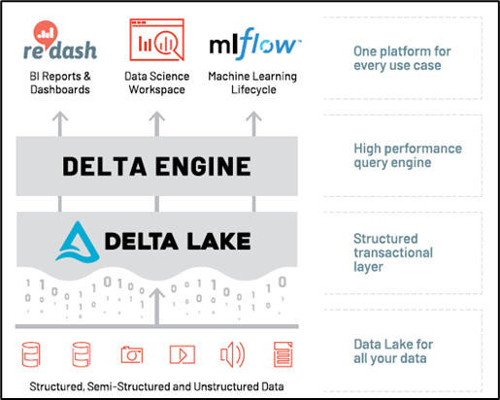

Easy access to high volume, historical and real time process data for analytics applications, engineers, and data scientists wherever they are
RTDIP (Real-Time Data Ingestion Platform) is a framework that simplifies the ingestion and processing of real-time industrial data. It provides a standardized way to handle high-volume data from sources like sensors and SCADA systems, making it accessible for building analytics, AI, and machine learning applications for the energy sector.
Real-time Data Ingestion: Provides tools to securely and efficiently ingest high-volume, real-time data from a wide array of sources.
Data Standardization: Transforms raw data from various sources into a consistent, analyzable format.
Query Engine & APIs: SDK and APIs to allow users to perform complex real-time queries and interact with data.
Scalability & Multicloud: Highly scalable and can be deployed across various cloud environments.
Supports Analytics: Simplifies the preparation and management of data for use in advanced analytics, AI, and digital twin applications.

Slide 51

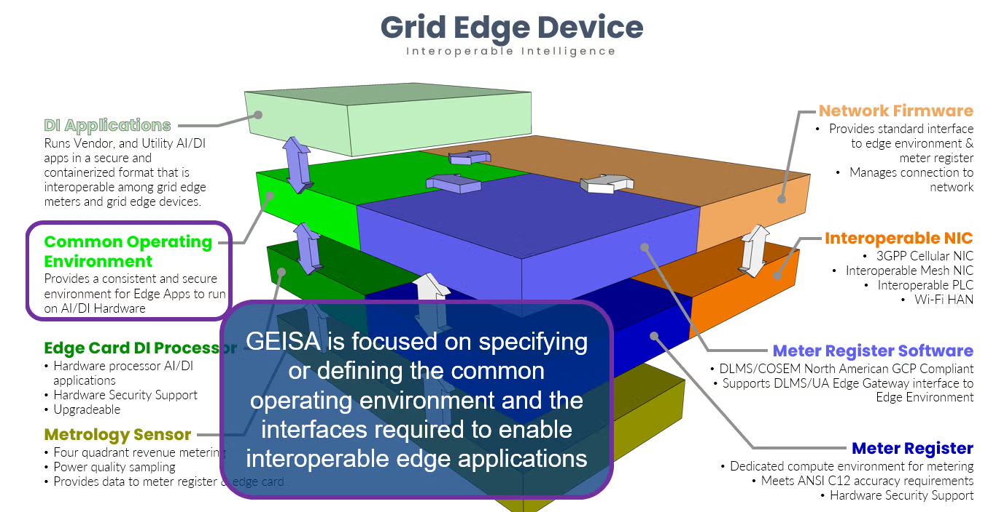







Secure, interoperable ecosystem to streamline the cybersecurity, deployment, scaling and operation of next-generation grid edge computing and applications
GEISA (Grid Edge Interoperability & Security Alliance) is a project that provides a secure, vendor-neutral specification for grid edge computing. It creates a common foundation for running applications on devices like smart meters, which streamlines deployment, reduces cybersecurity risks, and accelerates innovation in grid operations.
Vendor-Neutral Specification: Defines a uniform runtime environment for grid edge devices.
Cybersecurity: Creates a secure ecosystem to reduce risks and the audit burden.
Application Deployment: Standardizes the management and deployment of edge applications.
Interoperability: Enables utilities to run multi-vendor applications on one fleet.
Grid Operations: Supports advanced functionality for grid operations and AI.

Slide 52

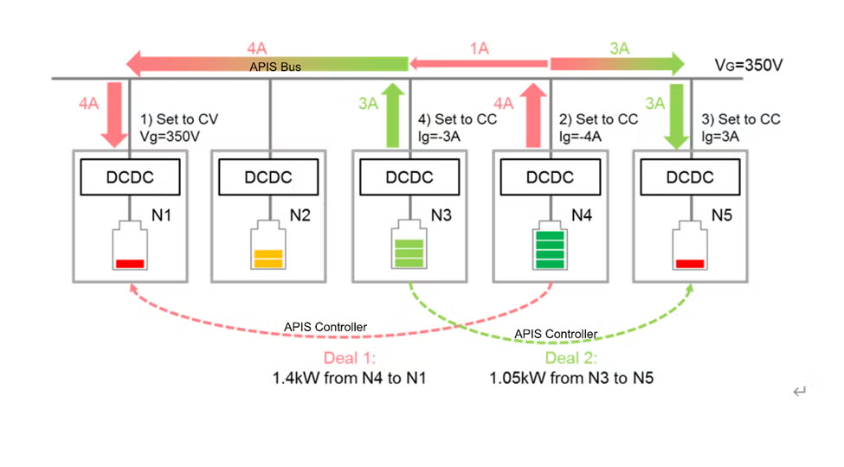

Microgrid orchestrator designed to enhance grid resilience and flexibility
Hyphae is a microgrid initiative that automates the peer-to-peer distribution of renewable energy, focused on building an interoperable, AC- and DC-ready microgrid platform. Hyphae aims to make microgrids more resilient and flexible, enabling them to operate autonomously and connect seamlessly to the electrical distribution network.
Microgrid Automation: Automates the peer-to-peer distribution of locally-produced renewable energy.
AC/DC Interoperability: Designed to work with both AC and DC grids to maximize flexibility.
Autonomous Operation: Enables microgrids to be self-contained and operational when disconnected from the main grid.
Resilience Enhancement: Helps to make microgrids more resilient and better equipped to handle energy fluctuations.
Decentralized Energy: Facilitates the use of decentralized energy resources and off-grid electrification.

Slide 53



Friendly and compliant implementations of OpenADR 2.0b and OpenADR 3.0
OpenLEADR is an LF Energy project providing free and open source implementations of the Open Automated Demand Response (OpenADR) protocol – an industry standard for enabling energy flexibility across grids, devices, and services. With the release of a new Rust-based implementation of OpenADR 3.0, OpenLEADR now supports both legacy and next-generation OpenADR deployments through two maintained versions:
OpenLEADR 2.0 – Python-based implementation of OpenADR 2.0b (IEC 62746-10-1 ED1)
OpenLEADR 3.0 – Rust-based implementation of OpenADR 3.0 (currently in pre-standardization)

Slide 54

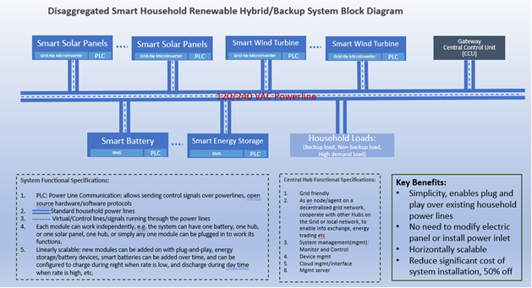

Open Renewable Energy Systems
ORES (Open Renewable Energy Systems) is an initiative that develops open standards and a flexible architecture for interoperable, modular, and intelligent energy systems. It supports a broad range of initiatives, from clean energy asset integration to the simulation of autonomous energy networks, to empower communities in the energy transition.
Standardized Architecture: Creates open standards and APIs for renewable energy systems.
Microgrid Integration: Supports plug-and-play microgrid deployment.
Interoperability: Addresses fragmentation with common standards for energy devices.
Community-Driven Innovation: Supports community workstreams like Generative AI for Autonomous Renewable Energy (GAIFARE).
Decentralized Energy: Provides a foundation for scalable, decentralized energy systems.

Slide 55
Grid Simulation and Modeling

Slide 56

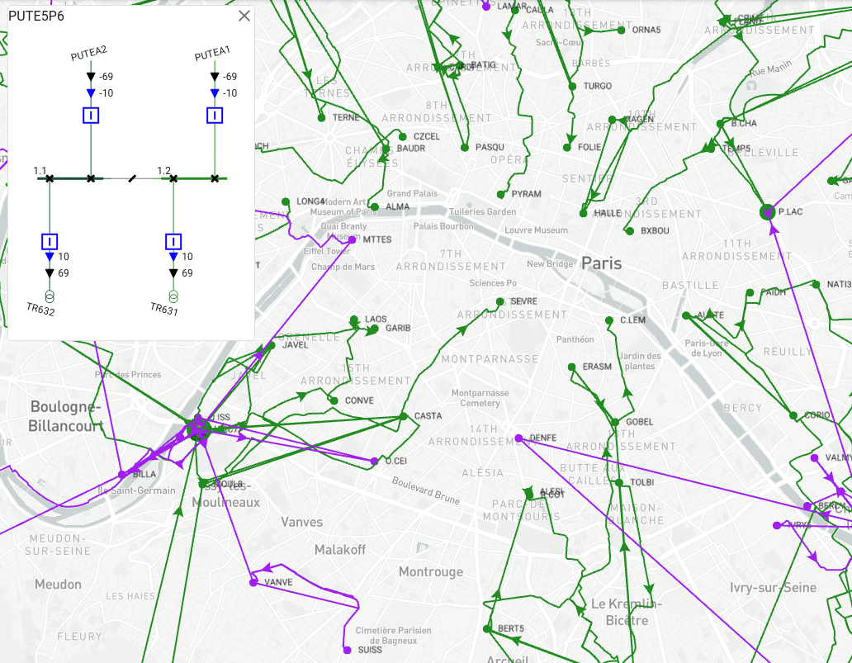






An open source library dedicated to electrical grid modeling, simulation and visualization.
PowSyBl (Power System Blocks) is a high-performance framework for power system simulation and analysis. It provides a modular and extensible set of tools for grid modeling, visualization, and advanced grid studies. PowSyBl helps grid operators and researchers understand and manage complex electricity networks, supporting critical functions like power flow analysis, security analysis, and the integration of new technologies.
Handle a large variety of formats, such as CIM-CGMES for European data exchanges;
Allow you to visualize the network and manipulate it endlessly;
Perform power flow simulations and security analyses on the network;
Optimize remedial actions in the network in order to relieve operational limits violations;
Perform short-circuit analyses on the network;
Perform dynamic simulations on the network.

Slide 57

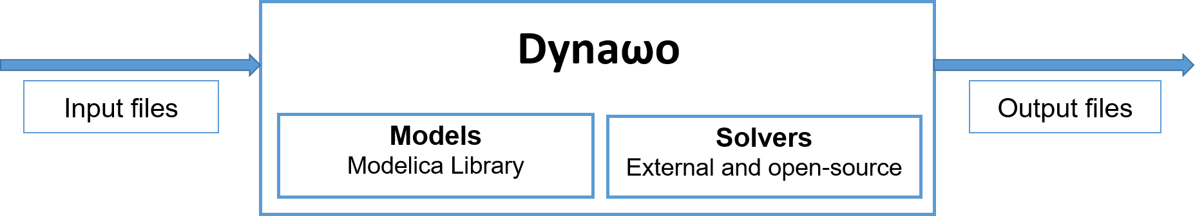
Simulation tools designed for analysis of power systems, including steady-state, short-circuit, and various stability studies
Dynawo is a powerful suite of simulation tools for the dynamic stability analysis of power systems. It provides a flexible and robust framework for understanding the grid's short-term behavior.
Dynamic Stability Analysis: Simulates the behavior of power systems in response to disturbances, such as short circuits or power plant outages.
High-Fidelity Modeling: Uses the Modelica language to provide transparent and detailed models of grid components.
Performance & Flexibility: Designed for fast simulations of large-scale networks and allows for the easy integration of new models and solvers.
Comprehensive Suite: Includes specific tools for a range of calculations, from steady-state (DynaFlow) to short-circuit (DySym) and various stability studies.
Interoperability: Works with other projects like PowSyBl to ensure seamless data exchange.

Slide 58

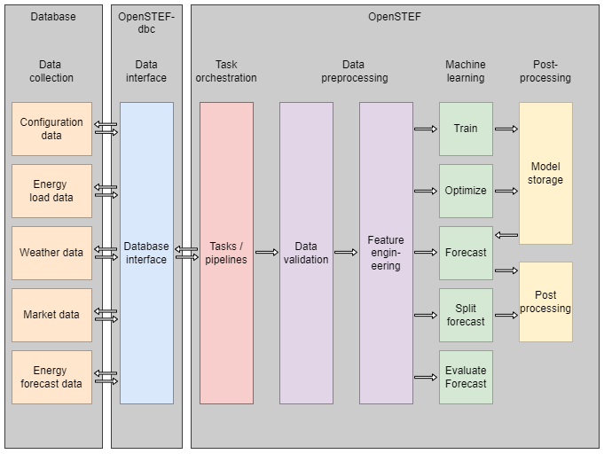



Automated machine learning pipelines for short-term energy forecasting of grid load, including consumption and renewable generation
Automated machine learning platform to provide accurate short-term forecasts for electricity grids. It is specifically designed to help grid operators predict electricity demand and generation over a short time horizon (e.g., up to 48 hours).
Operational forecasts: Accurate forecasts enable utilities to anticipate congestion and plan resource allocation more effectively.
Real-time data analysis: OpenSTEF leverages real-time data from grid sensors and weather forecasts to provide timely insights.
Customizable solutions: OpenSTEF offers customizable solutions tailored to the unique needs of each utility, ensuring maximum efficiency and effectiveness.
Infused expert energy knowledge: build-in energy knowledge to improve your forecasting quality. For example, additional weather features are automatically calculated and implemented.

Slide 59

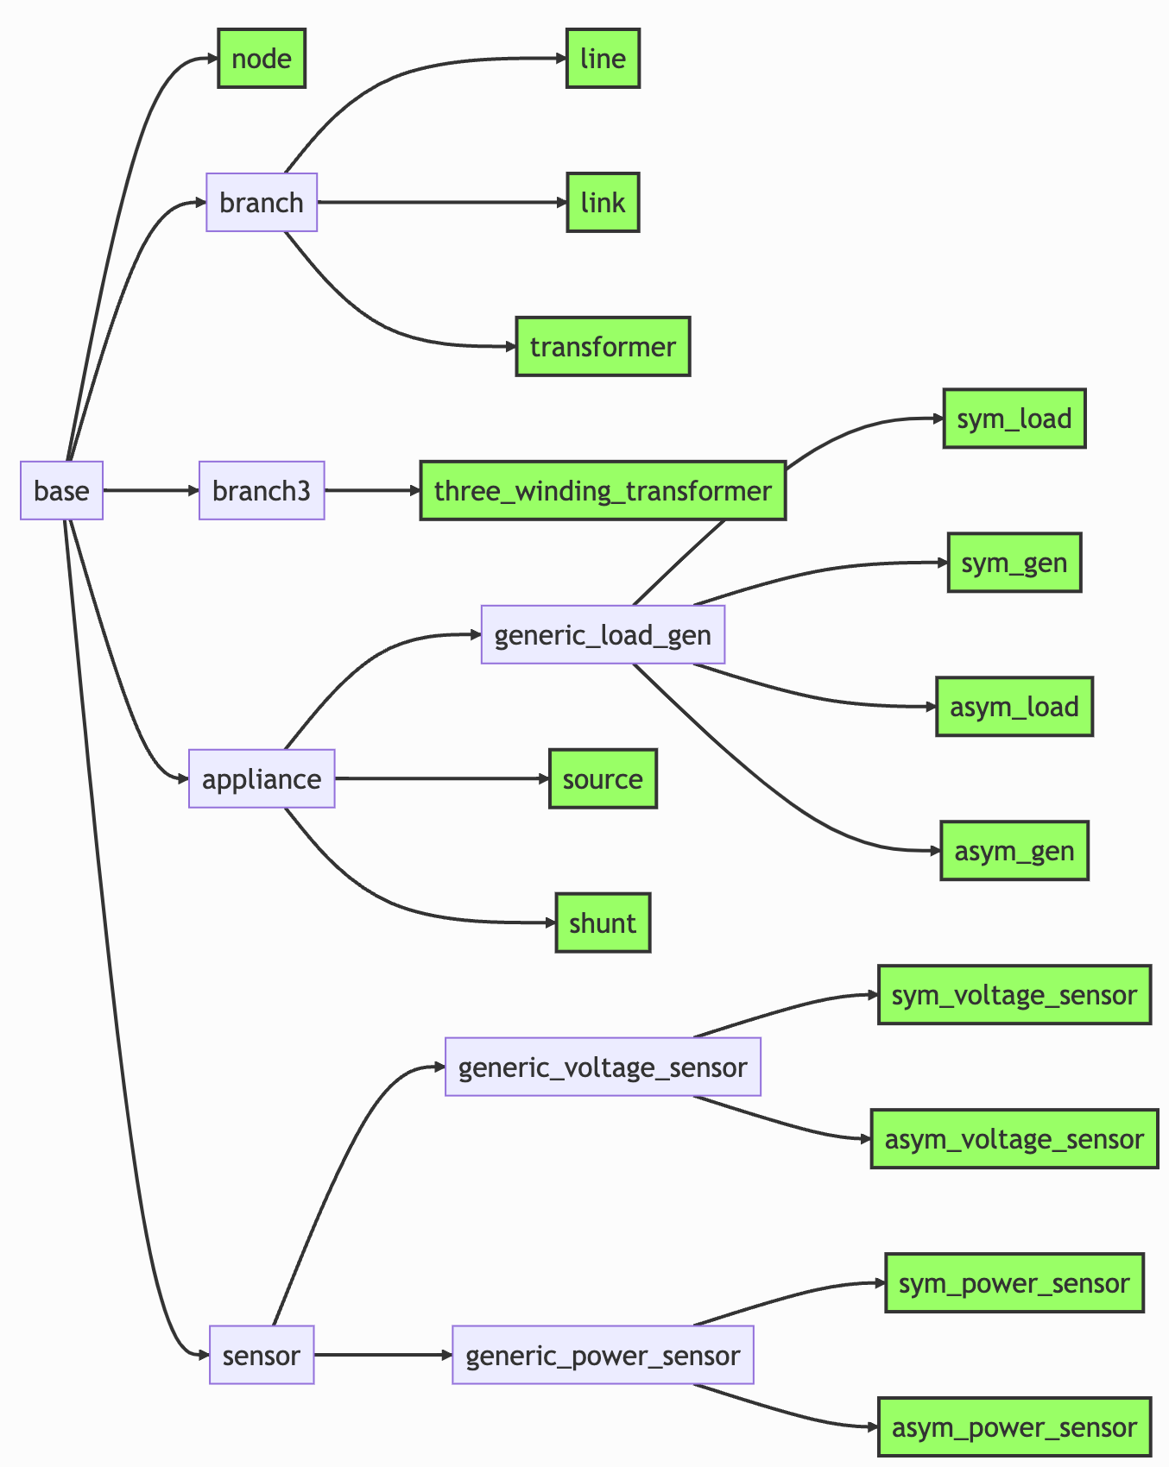






High-performance calculation engine for real-time steady-state distribution power system analysis
Power Grid Model is a high-performance calculation engine for distribution power system analysis. It provides a standards-based foundation for real-time analysis and simulations, helping Distribution System Operators (DSOs) with critical tasks like grid planning and congestion management.
Power system calculation functionalities: power flow, state estimation, short circuit
Linear methods available
Symmetric and asymmetric calculation
High-performance implementation in C++ with native parallelization
API (Application Programming Interface) in Python and C
Cross-platform

Slide 60

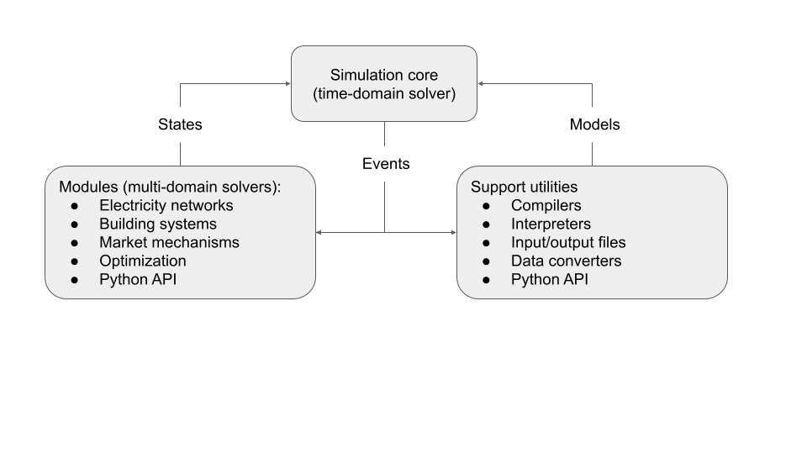




Open source, high performance power grid simulation for distribution grids and distributed energy resources
Arras is a high-performance simulation platform for future electricity distribution power systems. It provides a powerful engine for large-scale simulations, helping utilities and researchers analyze complex scenarios involving smart grid technologies and distributed energy resources.
High-Performance Simulation: Performs very large-scale simulations of distribution systems.
Distributed Energy Resources: Models the integration of renewables and other distributed resources.
Advanced Use Cases: Supports analysis for hosting capacity, tariff design, and grid resilience.
Developer-Friendly: Provides an extensible framework with APIs and cloud support.
Industry Integration: Integrates with industry tools and data sources like AMI and SCADA.
Contributions by

Slide 61

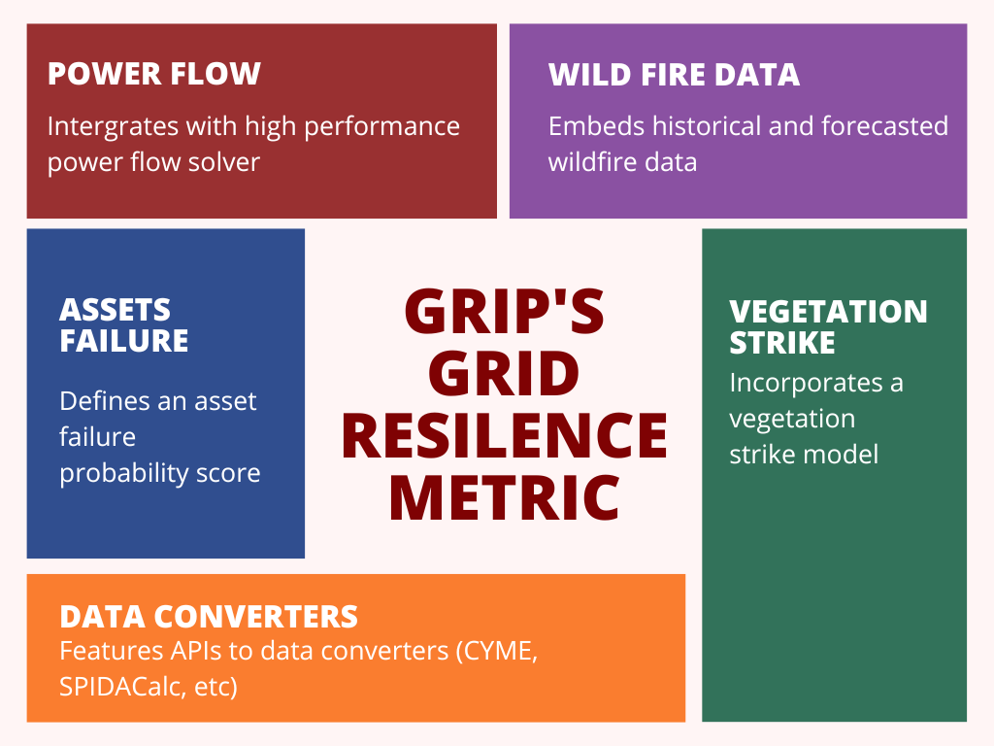
Predict, prepare for, and recover from the impacts of extreme weather events
GridVantage is a software platform that helps grid operators anticipate, mitigate, and recover from extreme weather events. It uses advanced modeling and resilience metrics to provide actionable insights and enhance the overall resilience of the electrical grid.
Extreme Weather Mitigation: Helps operators respond to and recover from extreme weather.
Agent-Based Modeling: Uses advanced modeling to simulate grid behavior.
Resilience Metrics: Quantifies grid asset health to measure resilience.
Actionable Insights: Provides recommendations for proactive measures and crew deployment.
Cost Optimization: Reduces costs by optimizing grid hardening investments.

Slide 62

Model and software for hazard risk analysis of extreme events
covXtreme is a statistical model and software for hazard risk analysis of extreme events. It performs non-stationary, multivariate extreme value analysis to understand the characteristics and quantify the risks of exceptional events, making its methods applicable to assessing the impact of natural phenomena on grid infrastructure.
Extreme Value Analysis: Analyzes extreme events using statistical models.
Covariate-Dependent Models: Incorporates factors like weather and season to model extreme events.
Multivariate Analysis: Quantifies extremes across multiple variables simultaneously.
Risk Quantification: Performs quantitative risk analysis for resilience planning.
Uncertainty Modeling: Quantifies the uncertainty in its predictions.

Slide 63

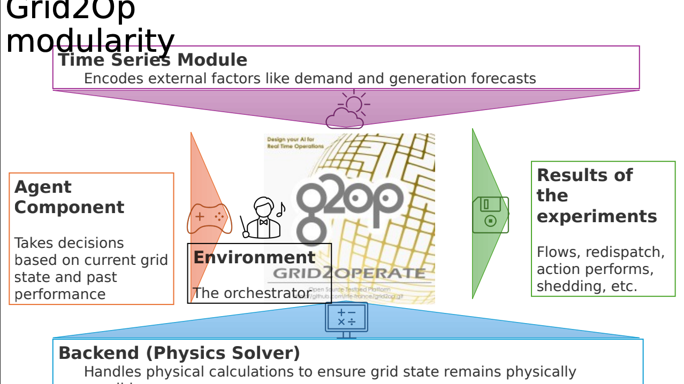
Framework, to be able to develop, train or evaluate performances of agents that acts on a power grid
Grid2Op is a platform for research into power grid control using AI and reinforcement learning. It provides a realistic simulation environment for training AI agents to operate a grid by reacting to events and optimizing for efficiency and resilience.
AI-driven Control: Develops and evaluates intelligent AI agents for grid control.
Realistic Simulation: Simulates real-world grid conditions and operational scenarios.
Reinforcement Learning: Supports training autonomous agents using reinforcement learning.
Research & Benchmarking: A powerful tool for testing and comparing control algorithms.
Grid Resilience: Helps improve the grid's ability to handle disruptions.

Slide 64

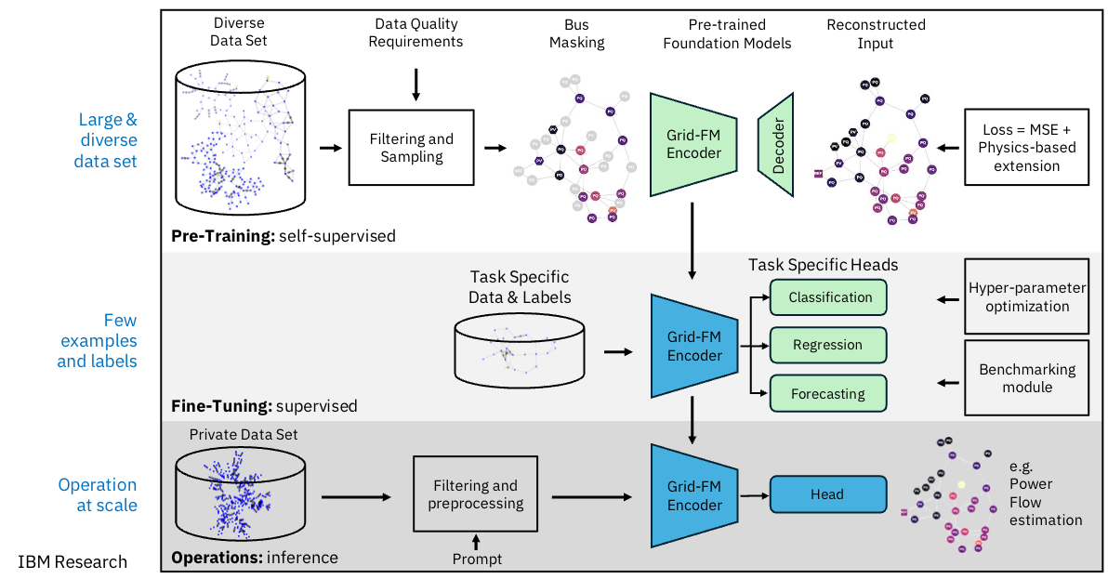


AI Foundation Models for Power Grids
GridFM is a framework that enables the development of large AI foundation models for power grids. These models are pre-trained on extensive grid datasets to capture the complex dependencies within the power system. GridFM aims to address the challenges of grid transformation by providing a powerful AI representation that can be fine-tuned for a broad set of applications, from load forecasting to system security, with a significant speed-up in computation.
Model pre-training
Data zoo
Power flow
Model validation and benchmarking

Slide 65
Contribute to our projects - anyone can!
Contribute to an existing project:
Submit a PR with a bugfix or new feature
Pick existing GitHub issue as a sample project
Integrate with a new app / contribute plugin
Help improve project documentation
Submit additional test cases
Join the TSC discussion: dev mailing list, conf calls
Get involved with the TAC or Working Group:
DevOps / CI expertise always useful
Interest / expertise in security especially welcome
Join the TAC discussions: mailing list, conf calls
More information at https://tac.lfenergy.org/engagement/

